Slide 1
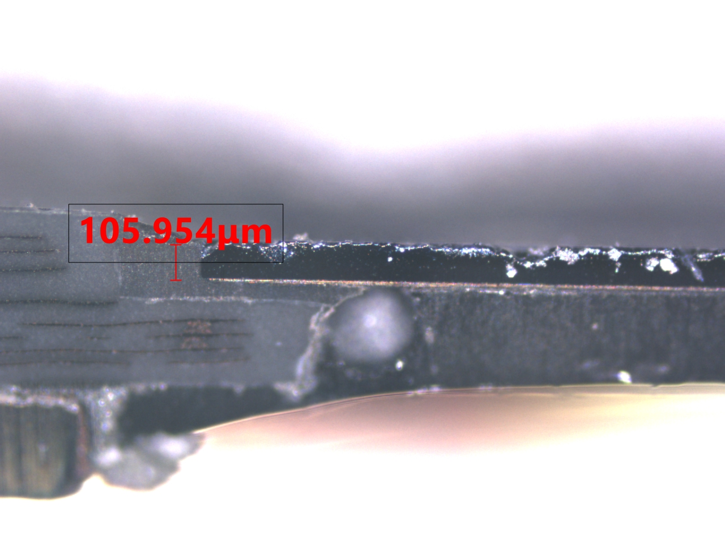
[DX] Automation for PBO/MBO.
Team: NPI 1
Ideas: Automation extract data from image at Under fill process.
Method: Using py-tesseract OCR to extract data from image
■ Requester: Phan Xuan Nam VH010418
■ Implementer: Phan Xuan Nam VH010418
■ Completion Date: July/2022
Create a program automatically extract data from image.
DX Level
Digitizing | Automation | Intelligence
 | O
Before
Improvement
After
Repetitive work
Replace repetitive task
Quantitative effect
After taking picture from microscope, DRI/engineer must take data from picture piece by piece to submit PBO
Make a python tool to automatically extract data from images
120m
Reduce 115 min
(98,3%)
Pre-improvement process
Post-improvement process
5m
Input image as a list or in a folder.
 | Before | After
Total working time | 120 mins | 5 mins
→ 105.954
Processing through a python tool.
- Total time preserved per week: 345 mins
- Total time preserved per year:
= 345/60 x 51weeks = 293.5h
- Total money saved:
= time saved x labor cost per hour
= 293.5 * 102,000 = 30,000,000 VND/year
Manually extract number from the picture.
Take number input as PBO data in excel.
Total time calculated:
Output as a list data in excel
Qualitative effect
- Eliminate human error & increase
accuracy
- Reduce workload, improve report quality
- Continuing apply for other process.
Input data to make PBO
33x4 = 132 images/PBO
Approximately ~ 30sec/pic
~ 1 hour/PBO/132 images
Grade A
Grade S3
Grade S2
Grade S1

